Slide 1
Iowa abc book
By: Adam Mander
You want IT ALL!!!!!

Slide 2
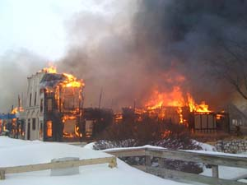
A Is For
Adventure Land
There is only 1 Adventure Land in the whole USA. It’s the biggest amusement park in Iowa.
Well….that’s not good.

Slide 3
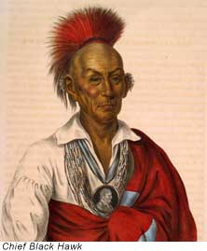
B Is For
1.Black Hawk was born in 1832.
2.He died in 1903.
When Chief Black Hawk was very young he became brave. Black Hawk was a War Chief who led his Sauk tribe to war. Black Hawk went to prison for fighting for his land in Iowa. He refused to give in without a fight.

Slide 4
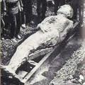
C Is For
Cardiff Giant
He was very famous in the hoaxes of the united states history. he was 10 feet tall. He was created of a New York tobacconist named George Hull. He was an atheist. He decided to create the giant after an argument at a Methodist.

Slide 5
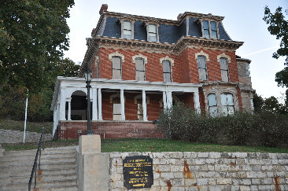
D Is For
Dodge
House.
Dodge house
Grenville Dodge worked for the Union Pacific Railroad. His wife started the construction on their house in Council Bluffs, IA. The mansion cost $35,000 dollars . It has 14 rooms and 3 stories. he died in January 3,1916, from cancer, he was 84 years old .

Slide 6
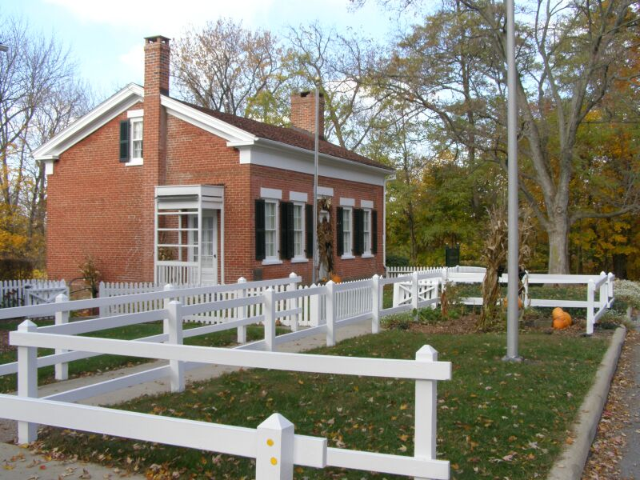
Thomas Edison
Thomas Edison had three children: Madeline Edison (1888-1979),Charles Edison(1890-1969),(1898-1937). Thomas Edison lived until (1847-1937)
E is for Thomas Edison

Slide 7
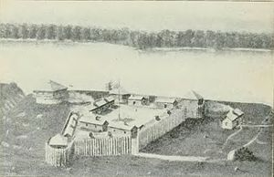
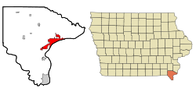
Fort Madison
Fort Madison is by the Mississippi River and Lee county too. The other county set is Keokuk. It was the U.S. military fort.
F is for

Slide 8
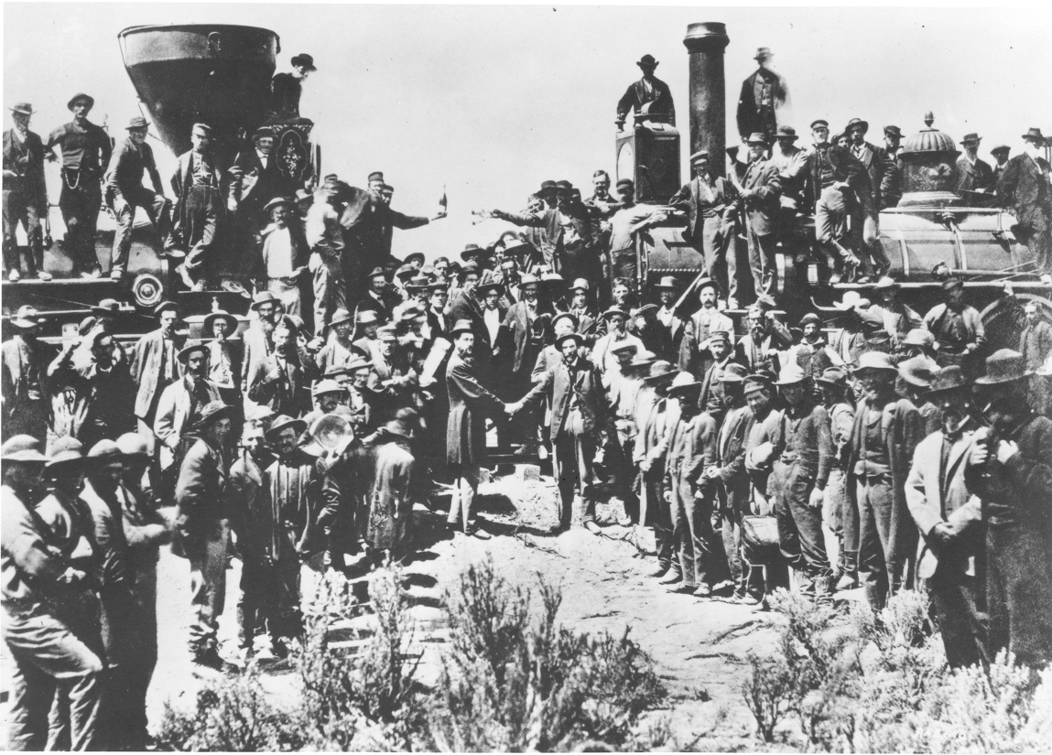
G is for General Dodge
General Dodge
General Dodge joined the Union Army. He was born (April 12,183)-died (January 3,1916),He aged to 84.
General Dodge

Slide 9
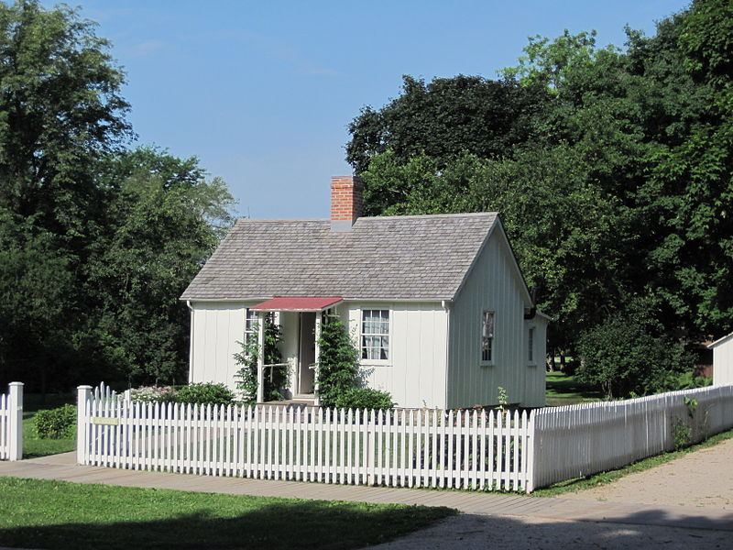
H is for herbert hoover
Herbert Hoover
Herbert Hoover was born August 10, 1874 in West Branch, Iowa. He was the 1st president born west of the Mississippi river and remains the only Iowan president.

Slide 10
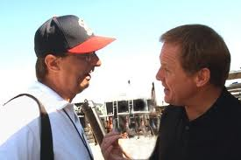
I is for Iowa speedway
Iowa Speedway
It is 7/8-mile long. It was opened in 2006. Steve Wallace won there In 2006 , he was racing a ARCA Remax series car and Kyle Bush won there in 2010 he was racing a nationwide series car
Rusty Wallace at Iowa speedway

Slide 11
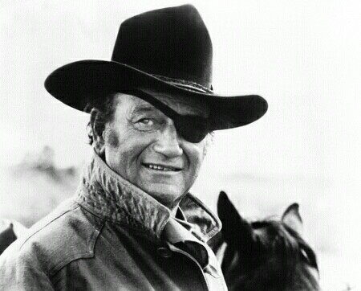
J is for John Wayne
He was born in may 26, 1907 and died June 11, 1979. He was born in Winterset Iowa . Located of death Los Angeles, California. He died because of stomach c

Slide 12
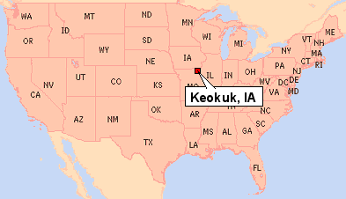
K is for Keokuk
Situated between the Des Moines and Mississippi River, the area that became Keokuk had access to a large trading area and was an ideal location for settlers. In 1820, the US army , prohibition soldiers stationed a long the Mississippi River from having wives who were Native Americans.

Slide 13
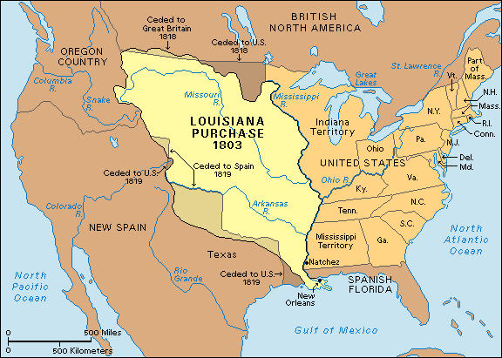
L is for Louisiana purchase
The Louisiana purchase was the largest and most extraordinary land purchase in the history of United States. It was also the cheapest (per square feet).
At the turn of the 19th century, Americans were moving further west ward.
Settler had crossed the Appalachian mountains and headed for parts known and unknown. Pioneers like Daniel Boone had blazed trails and roads, allowing families to travel to new places. Soon, the northwest territory and other places were bustling with Americans.

Slide 14
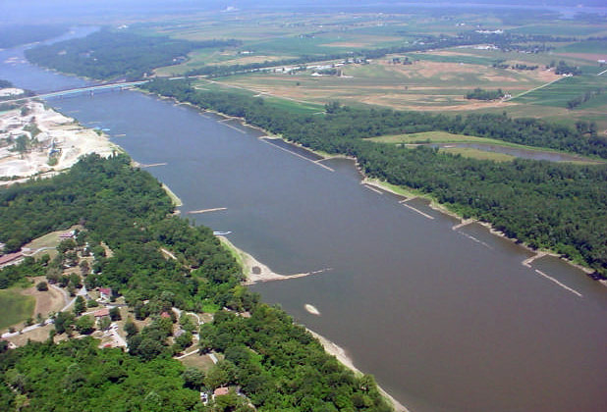
M is for Missouri river
The Missouri River is a major river of central North American, and is a tributary of the Mississippi River. It is the longest river in the continent at over 2,341 miles long and second longest tributary of the Mississippi by discharge, after the Ohio river. The watershed of the Missouri River drains nearly53,000 square miles of the eastern Rocky Mountains and the Great Plains.

Slide 15
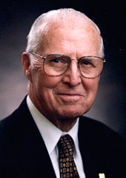
N is for Norman Borlaug
Was born in Cresco ,IA on March 25,1914 and died in Dallas, Texas on September12, 2009. During the mid 20th century , Borlaug led the introduction of these high yielding veracities combined with modern agriculture production techniques to Mexico, Pakistan, and Indiana.

Slide 16
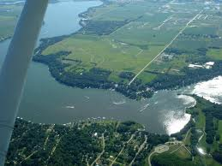
O is for Okoboji
Okoboji is a city in Dickinson, IA, along the eastern shore of west Okoboji lake in the Iowa Great lakes region. The population was 820 at the 2000 census. Pikes point state park is located within the city limits. Okoboji is served by KUOO-FM and KUOO-FM.

Slide 17
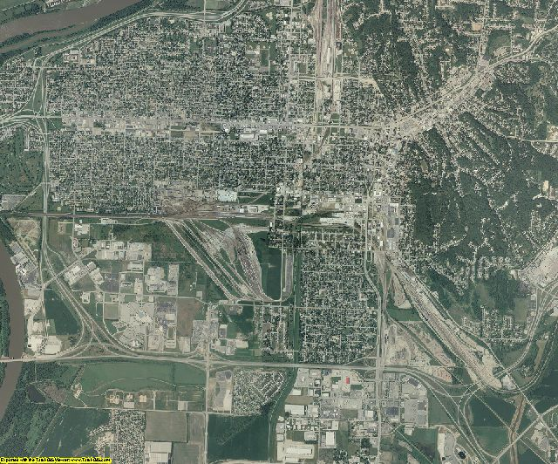
P is for Pottawattamie county
Founded in September 21, 1848. Pottawattamie county is a county located in Iowa. As of 2000, the population was 87,704. the second large county in Iowa, the Pottawattamie county seat is located at Council Bluffs. It is of three Iowa counties in the eight –county Omaha – Council Bluff Metropolitan Statistical Area. The county takes its name from the Powatomie Native Americans.

Slide 18
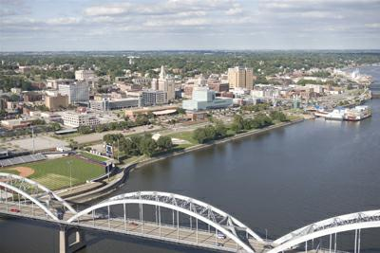
Q is for Quad cities
The Quad cities is a group of 5 cities trading the Mississippi on the Iowa-Illinois boundary. These cities m Davenport and Bettendorf( in Iowa) and Rock island, Moline, and East Moline (in Illinois), are the center of the Quad cities Metropolitan, which as of 2010, had an estimated population of 379,690 and was the largest 360-mile market States west of Chicago.

Slide 19
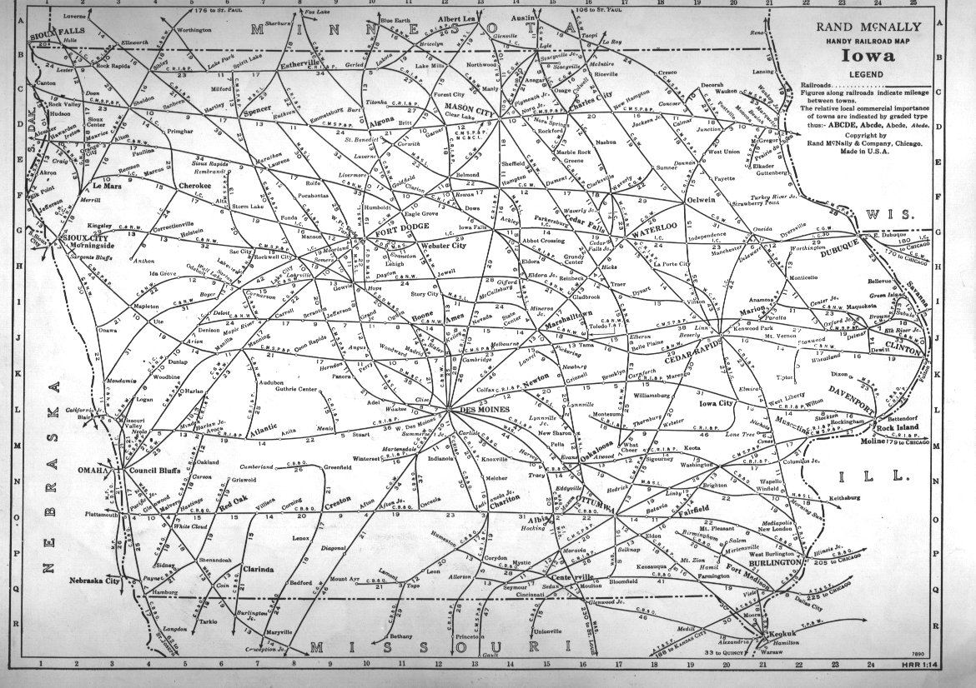
R is for railroads
As thousands of settlers poured into Iowa in the mid-19th century, all shared a common concern for the development of adequate transportation. The earliest settlers shipped their agricultural goods down the Mississippi River to New Orleans, Louisiana, but the 1850’s, Iowan had caught the nations railroad fever

Slide 20
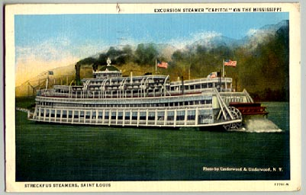
S is for steamboats
The crew threw more wood on the fire. The steamboats needed a lot of steam power to pull away the shore. The giant paddle wheel started

Slide 21
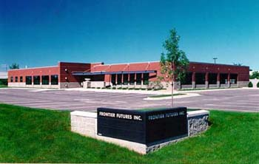
T is for International Traders of Iowa
The International Traders of Iowa (ITI) is an organization whose mission is to serve the businesses in Iowa in their pursuit of world trade. Through forums developed to exchange practical information

Slide 22
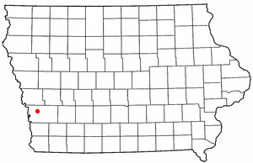
U is for Underwood, IA
Underwood is located in Norwalk township, so the early history of the township is also of the town. The historical information provided here was taken from a book on Pottawattamie County past. The principal early settlers of the area arrived during the period from 1845 to 1850. in 1847, a flourmill and a sawmill built on Mosquito Creek, southwest of the present site of near the school and sawmill. It became known as Downsville. A post established there

Slide 23
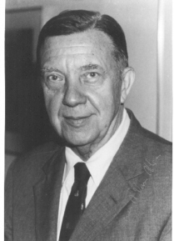
V is for James Van Allen
September 7, 1914: James Van Allen was born in Mount Pleasant , Iowa. His boy hood home, once maintained as a museum to him, is slated to be demolished soon

Slide 24
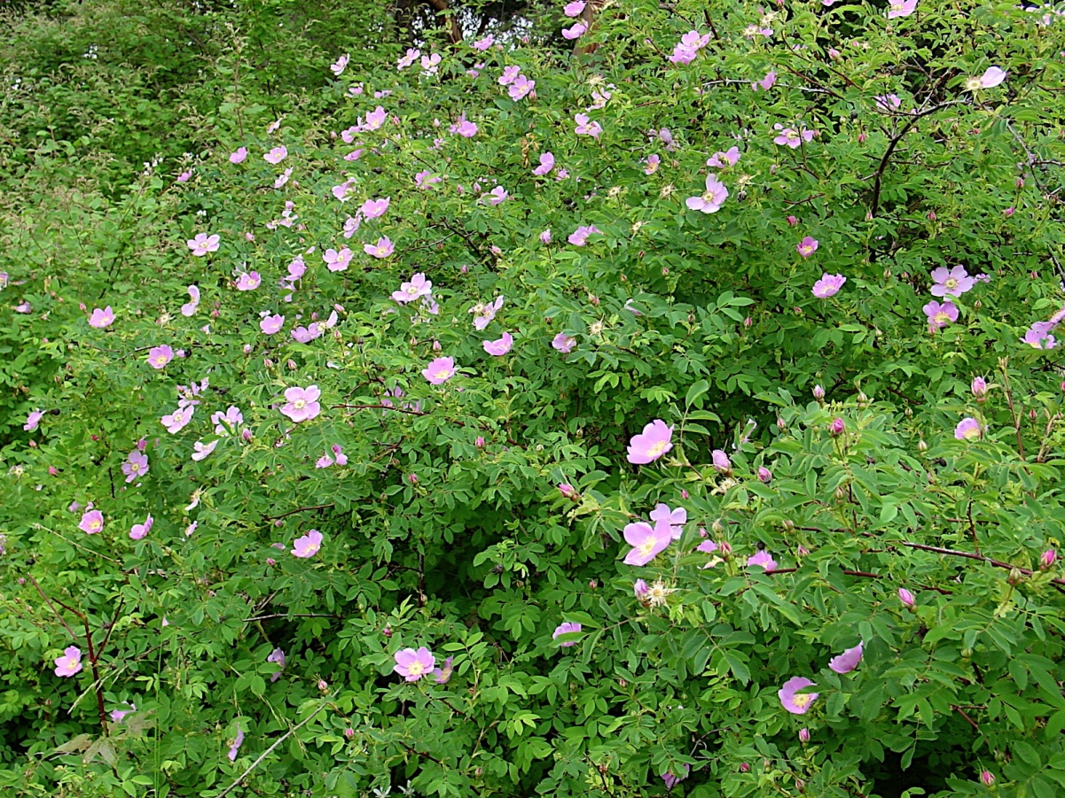
W is for Wild rose
The Iowa Legislature designated the Wild rose as the official state in 1847. it was one of the decoration used on the Silver service which the state presented to the battleship USSI owa that same year

Slide 25
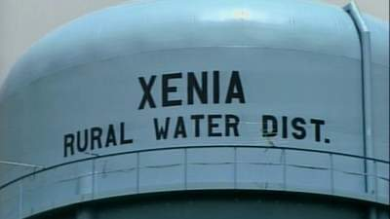
X is for xenia water district
The drought of 1977 forced landowners east of Woodward to explore new water service options after their private wells went dry. These individuals obtained an FnHa loan in 1978 and received funding to make their endeavor possible in 1981.

Slide 26
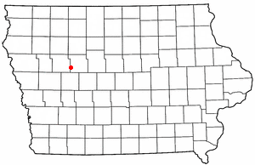
Y is for Yetter
In the city the population was spread out of which 22%2 had children under the age of 18 living with them, 33%3 were married couples living , 11%1 had a female house holder with them with no husband present.

Slide 27
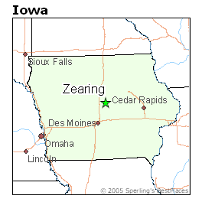
Z is for Zearing
Zearing was formed out of Lincoln township, being founded on October 17,1881 and incorporated on February 6, 1883 . It was named for William Mitchell Zearing, a judge from Chicago who donated a bell to the first church in the community.

Slide 28
Adam Mander
THE END

